Slide 1
19CSE330-Embedded Systems

Slide 2
Evaluation Policy
**L-T-P-C: 3-0-3-4
Assessment- 65:35 | Internal -65 | External -35
Mid Term Exam | 10 (Online) + 10(Viva)
Continuous Assessment Theory (CAT) | 15
Continuous Assessment Lab (CAL) | 30
End Semester Exam |  | 15 (Online) + 20 (Viva)
Continuous Evaluation Theory -15%
4 Assignment – 10%
2 Class Test - 5%
Continuous Evaluation Lab -30%
9 Lab Sheet Evaluation – 5%
Project – 5%
Internal Exam - 10%
Final Exam –10%
End Semester Exam-35%

Slide 3
Text Book(s)
Furber SB. ARM system-on-chip architecture. pearson Education; 2000.
Martin T. The Insider’s guide to the Philips ARM7-based microcontrollers. Coventry, Hitex, UK, Ltd. 2005.
Reference(s)
Valvano JW. Embedded Systems: Introduction to ARM Cortex-M Microcontrollers.
Jonathan W. Valvano; 2016. Valvano JW. Embedded microcomputer systems: real time interfacing. Cengage Learning; 2012
https://courses.edx.org/courses/course-v1:UTAustinX+UT.6.10x+1T2017/course/
https://courses.edx.org/courses/course-v1:UTAustinX+UT.6.20x+2T2018/course/

Slide 4
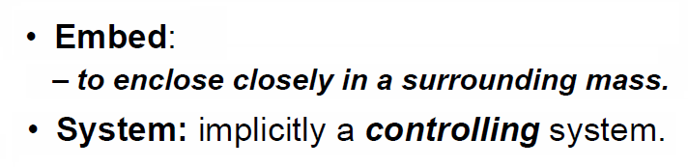
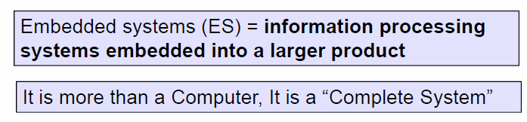
Definition
System: Anything which accepts input, processes it and presents the output in the required format can be a system.

Slide 5
What is an Embedded System?
“An embedded system can be defined as those control systems which are designed either by microprocessor or microcontroller for a specific tasks. ” OR
“An embedded system is some combination of computer hardware & software, either fixed in capability or programmable, that is specifically designed for a particular kind of application device. ” OR
“An embedded system is the one that has computer hardware with software embedded in it as one of its most important components.”

Slide 6
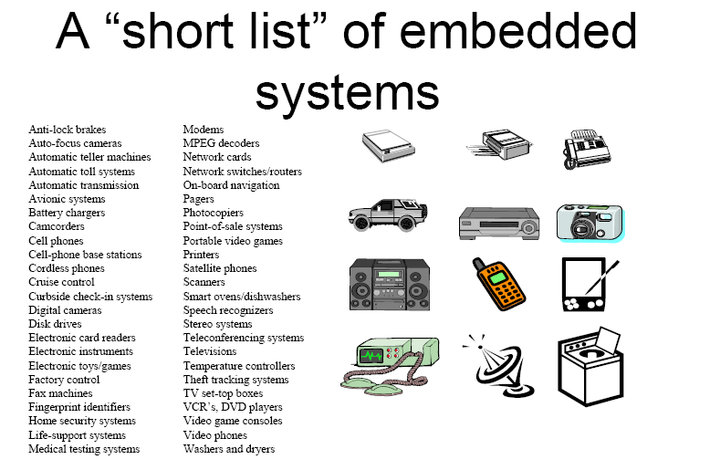

Slide 7
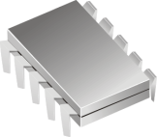
Embedded System Daily Applications
Digital clock
Moving message display
7 segment display
Traffic Light

Slide 8
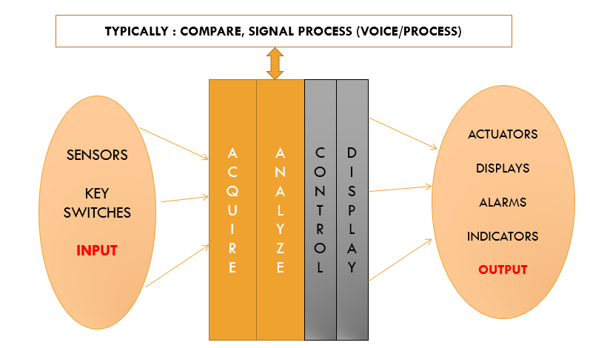
A Diagrammatic representation of Embedded Systems Architecture – Presented here!

Slide 9
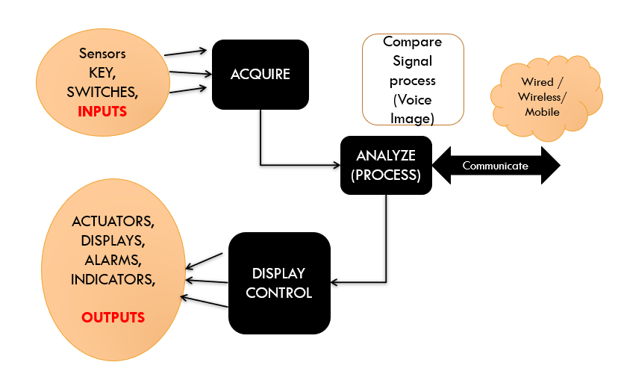
A Diagrammatic representation of Embedded Systems Architecture – Presented here!

Slide 10
Essential Components of Embedded Systems
The ES has three major components and they are classified as follows:
Hardware
Software
RTOS (Real Time OS)
Hardware:
Microprocessor / Microcontroller
Sensors
Converters (A/D and D/A)
Actuators
Memory (On-chip and Off chip)
Communication path with the interacting environment

Slide 11
Software:
Application software that can perform a series of task.
RTOS:
Defines the way the system works
Supervises the application software
Provides a mechanism to let the processor to run a process as per scheduling (Process scheduling)
Perform Context switching between the processes

Slide 12
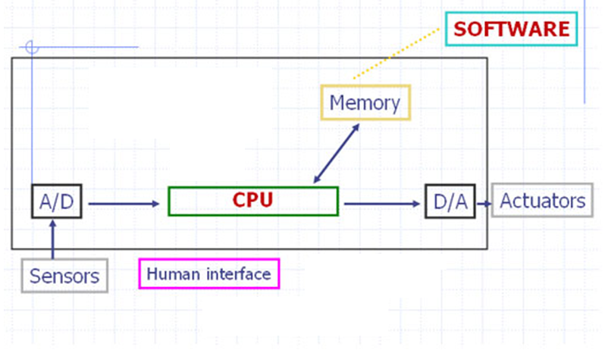
Block Diagram

Slide 13
Important Units of microprocessor/controller
CPU: Central Processing Unit
I/O: Input /Output
Bus: Address bus & Data bus
Memory: RAM & ROM
Timer
Interrupt

Slide 14





Microprocessor
General-purpose microprocessor
CPU for Computers
No RAM, ROM, I/O on CPU chip itself
Example--Intel’s x86: 8086,8088,80386,80486, Pentium
Data Bus
Many chips on mother board
CPU
General-Purpose Micro-processor
Serial COM Port
RAM
ROM
I/O Port
Timer
Address Bus
General-Purpose Microprocessor System

Slide 15
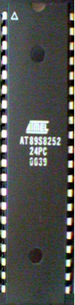




Microcontroller
A smaller computer.
On-chip RAM, ROM, I/O ports...
Example:- Motorola’s 6811, Intel’s 8051 and PIC 16X
CPU
RAM
ROM
A single chip
Serial COM Port
I/O Port
Timer
Microcontroller

Slide 16
Microprocessor v/s Microcontroller
Microprocessor
CPU is stand-alone, RAM, ROM, I/O, timer are separate
Designer can decide on the amount of ROM, RAM and I/O ports.
Expensive
General-purpose
Examples:-
8085,8086 microprocessors
Motorola6800,
Intel’s 8086, etc.
Microcontroller
CPU, RAM, ROM, I/O and timer are all on a single chip
Fixed amount of on-chip ROM, RAM, I/O ports
For applications in which cost, power and space are critical
Single-purpose
Examples:-
8051,
PIC mc,
Motorola
MC’s, Phillips, etc.

Slide 17
Main Architecture
Embedded processors are constructed into 2 main architecture
Von Neumann
Harvard

Slide 18
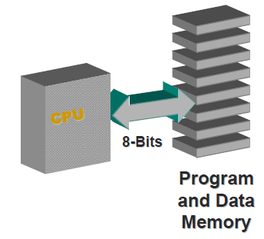
Von Neumann Architecture
Fetches instructions and data from same memory
Limits operating bandwidth

Slide 19
Harvard Architecture
Two separate memory spaces for instruction and data
Increases throughput
Different program and data bus widths are possible

Slide 20
Thank You

